Slide 1
SJTU SpeechLab E2E ASR System for the ASRU2019 Code-Switching Challenge
卢怡宙，李豪，黄明坤，钱彦旻
{luyizhou4, lh575526, mingkunhuang, yanminqian}@sjtu.edu.cn
Speech Lab,
Shanghai Jiao Tong University

Slide 2
Outline
Brief Introduction:
Overall System
Data Preparation
E2E ASR System
Model Structure
Data Augmentation & Training Strategies
Leverage Monolingual & Code-Switching Data
Experiments
LSTM VS Transformer
Leverage Monolingual & Code-Switching Data
Data Augmentation
Summary

Slide 3
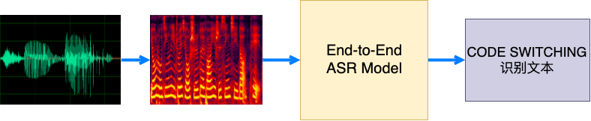
Brief Introduction: Overall System
Track 3 E2E-ASR: Overall System

Slide 4
Data Preparation
16kHz wav文件：
500h 中文数据、960h Librispeech数据、 200h 中英混合数据
20h 中英混合的dev集(新、旧)
20h 中英混合的测试集

Slide 5
Data Preparation
80维logmel filter bank特征,
Per Speaker CMVN / Per Utterance CMVN

Slide 6
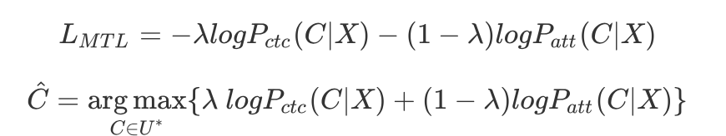
E2E-ASR Model
Sequence-to-Sequence Modeling Task:
Alignment & Classification
SAN based Joint CTC/Attention Model^{[1]}

Slide 7
Data Preparation
中文用单字建模，词频>=25，3006个字+UNK；
英文用BPE建模，1k个建模单元；
Universal character set；
例：▁CO DE ▁SW IT CH ING 识 别 文 本

Slide 8
Outline
Brief Introduction:
Overall System
Data Preparation
E2E ASR System
Model Structure
Data Augmentation & Training Strategies
Leverage Monolingual & Code-Switching Data
Experiments
LSTM VS Transformer
Leverage Monolingual & Code-Switching Data
Data Augmentation
Summary

Slide 9


E2E ASR System
Transformer^{[2]}结构
12层Encoder，6层Decoder
Convolutional DownSampling
Pre Layer Normalization
Transformer Structure in [2]

Slide 10
E2E ASR System
Joint CTC/Attention Model^{[1]}
Training λ=0.3
Decoding λ=0.4
Transformer Structure in [2]

Slide 11
Data Augmentation
Task-Independent augmentation
Specaugmentation^{[3]}
Speed Perturbation (0.9x, 1.0x, 1.1x speed)
混响
Task-Related augmentation
code-switching数据风格数据（裁剪、拼接）
Specaugmentation^{[3]} example

Slide 12
Training Strategies
Training Strategies
Uniform Label Smoothing
Gradient Clipping
Large Batch Size to Stabilize Training
Average Checkpoint
Learning Rate Schedule (warmup and decay)

Slide 13
Leverage Monolingual & Code-Switching Data
Transfer Learning^{[5]}：
Step1：预训练Librispeech模型M1
Step2：M1模型作为初始化，拿全部中文+部分英文数据+全部中英文混合数据训练模型M2
Step3：用M2模型在200h中英文混合数据上fine tune

Slide 14
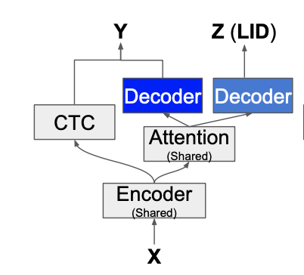
Leverage Monolingual & Code-Switching Data
LID Multitask^{[5,6]}
Language ID Multitask Training Using Attention Context Vector
LID-MTL^{[6]} example

Slide 15
Outline
Brief Introduction:
Overall System
Data Preparation
E2E ASR System
Model Structure
Data Augmentation & Training Strategies
Leverage Monolingual & Code-Switching Data
Experiments
LSTM VS Transformer
Leverage Monolingual & Code-Switching Data
Data Augmentation
Summary

Slide 16
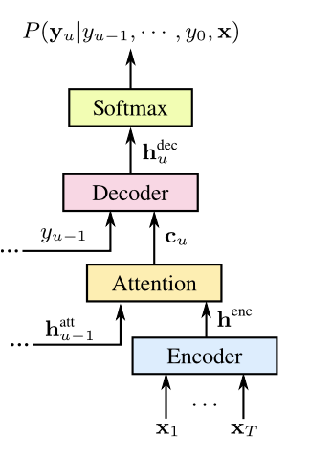
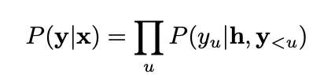
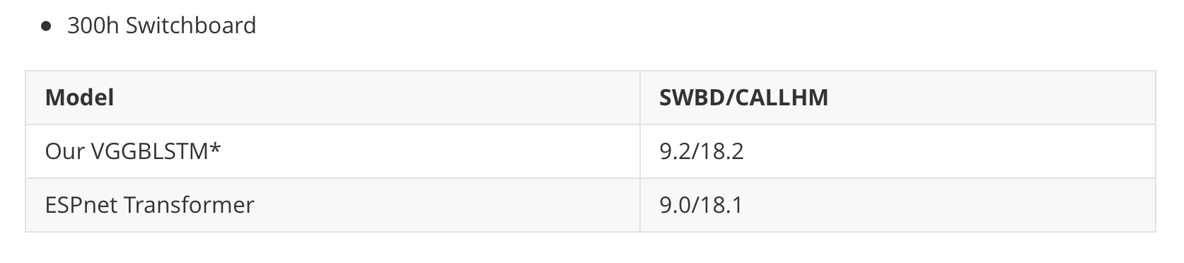
Experiments: LSTM VS Transformer
我们在比赛中尝试了两种结构：LSTM、Transformer…
LSTM Based LAS^{[4]}结构
Encoder：VGGBN + 5层512BLSTM (4x sampling)
Decoder：2层1024LSTM
Attention: Location-Aware Attention
S2S Model Structure^{[7]}

Slide 17
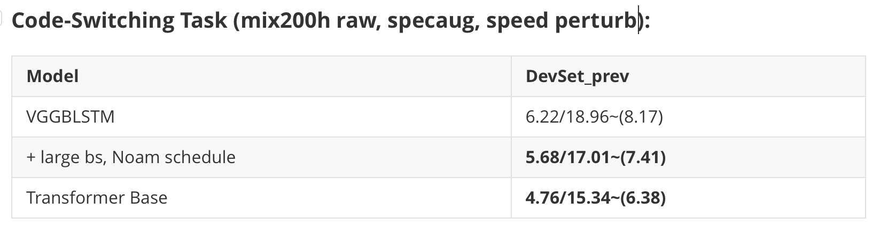
Experiments: LSTM VS Transformer
Transformer wins，but…（model size、hyper-parameters）

Slide 18
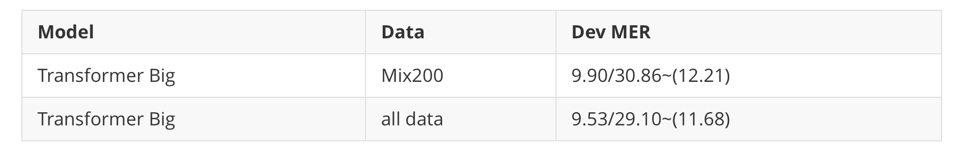
Leverage Monolingual & Code-Switching data
我们发现把全部中文、英文、中英混合数据放一起训练，并没有得到很好的效果 (在新的dev集合测试)
可能的原因：
Librispeech数据都是长语音(10几秒)，而中文/中英文混合数据都是短语音
中式英语和美式英语的差异

Slide 19
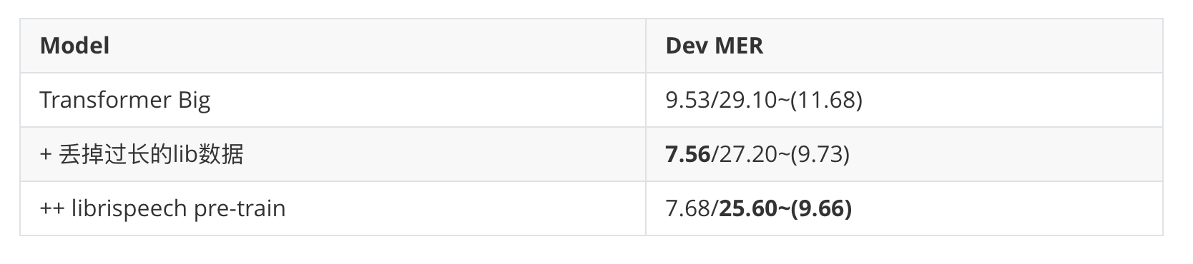
Leverage Monolingual & Code-Switching data
Tricks in Our Transfer Learning experiments:
Librispeech数据没利用上 ==> 丢掉过长的librispeech数据
丢掉过长的句子又没法全部利用上lib数据 ==> librispeech pretrain后初始化
同样的结论在LSTM结构下也适用
Adaptation？

Slide 20
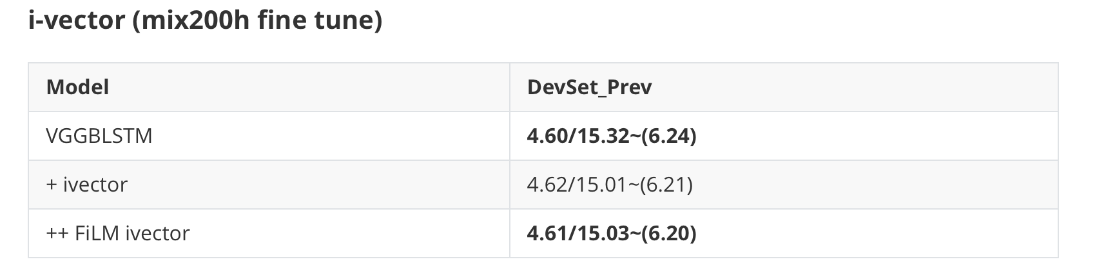
Leverage Monolingual & Code-Switching data
Speaker Adaptation：只在mix200h上测试i-vector实验，当时没做进一步实验（全部数据上的speaker adaptation）
Dataset Adaptation：Domain Adversarial Training？

Slide 21
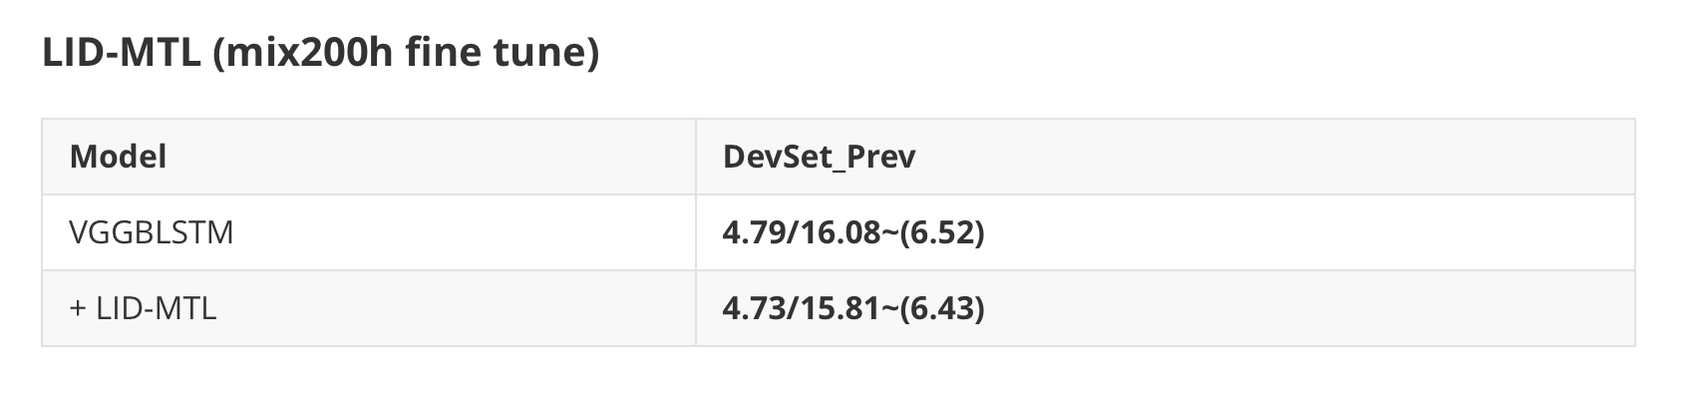
Leverage Monolingual & Code-Switching data
LID-MTL只有很小的提升

Slide 22
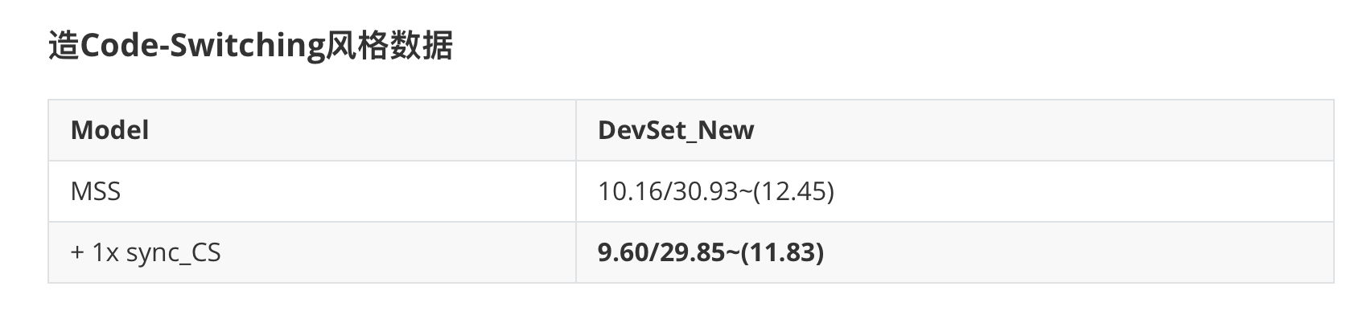
Experiments: Data Augmentation
Specaugment提升很大；
做完specaug后，Speed perturb改进有限，加混响没效果；
造code-switching数据在mix200训时有效，但是fine tune没做出来

Slide 23
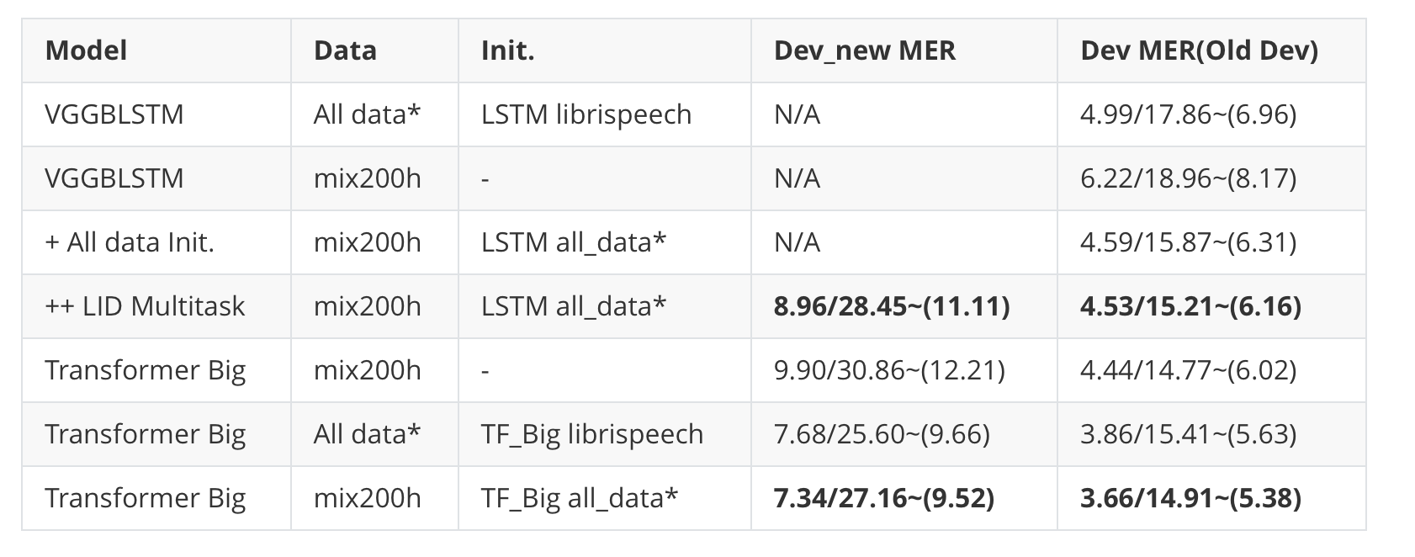
Experiments: Summary
Experiment Summary:
测试集结果: 6.93/24.35~(8.82), Track 3第二名:
Transformer实验由于时间原因没训完，fine tune没调好；
Language Model (rescore、LM fusion、spell correction)
Others：
data augmentation，LID-MTL，i-vector
mWER，DAT…

Slide 24
Reference
[1] Hori T, Watanabe S, Zhang Y, et al. Advances in joint CTC-attention based end-to-end speech recognition with a deep CNN encoder and RNN-LM[J]. arXiv preprint arXiv:1706.02737, 2017.
[2] Vaswani A, Shazeer N, Parmar N, et al. Attention is all you need[C]//Advances in neural information processing systems. 2017: 5998-6008.
[3] Park D S, Chan W, Zhang Y, et al. Specaugment: A simple data augmentation method for automatic speech recognition[J]. arXiv preprint arXiv:1904.08779, 2019.
[4] Chan W, Jaitly N, Le Q V, et al. Listen, attend and spell[J]. arXiv preprint arXiv:1508.01211, 2015.
[5] Shan C, Weng C, Wang G, et al. Investigating End-to-end Speech Recognition for Mandarin-english Code-switching[C]//ICASSP 2019-2019 IEEE International Conference on Acoustics, Speech and Signal Processing (ICASSP). IEEE, 2019: 6056-6060.
[6] Zeng Z, Khassanov Y, Pham V T, et al. On the end-to-end solution to mandarin-english code-switching speech recognition[J]. arXiv preprint arXiv:1811.00241, 2018.
[7] Prabhavalkar R, Rao K, Sainath T N, et al. A Comparison of Sequence-to-Sequence Models for Speech Recognition[C]//Interspeech. 2017: 939-943.

Slide 25
Thank you！
Q&A

